Slide 1

SARCASM DETECTION using deep learning
Hareetima Sonkar (Group-7)

Slide 2

Problem Description
● Sarcasm is a complex sentiment expressed using intensified positive or positive words typically intended to convey a negative connotation.
● The challenge lies in interpreting sarcastic content correctly, especially in Natural Language Processing (NLP) and sentiment analysis.
● Our goal is to build a model that can recognize and understand sarcastic behaviour and patterns in text

Slide 3
1. Business Problem
Misinterpreting sarcasm can lead to inaccurate sentiment analysis, which can adversely affect businesses in various ways:
- Customer Feedback
- Public Relations
- Brand Reputation Management
- Social Media Monitoring
- Ad Campaign Analysis

Slide 4
2. Solution Description
1. Data Collection, Preprocessing & Cleaning:
Data Loading
Duplicate Removal, Removing null values etc.
Data Summary
removing punctuations, stopwords, etc.
Visualizations
Descriptive Statistics
2. Text Tokenization and Padding
TensorFlow's Keras
Padding type = 'post’
3. Model Training
Model Architecture
Data Splitting
Training
4. Model Evaluation
Performance Metrics
Visualizations
5. Prediction

Slide 5

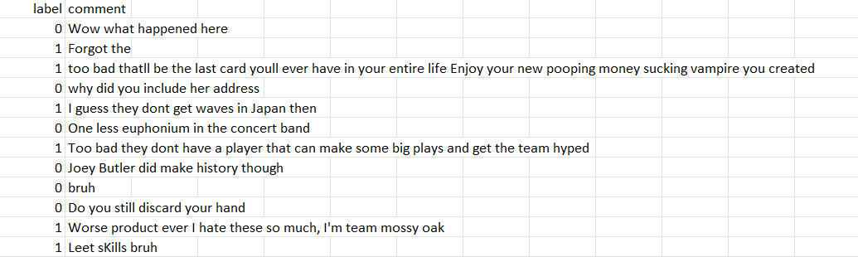
3. Dataset Description
- The dataset contains text comments labelled as sarcastic (1) and non-sarcastic (0).
- Each comment is a short piece of text sourced from social media or other platforms [Reddit].
- Dataset size: 1million (approx.)
Examples:

Slide 6
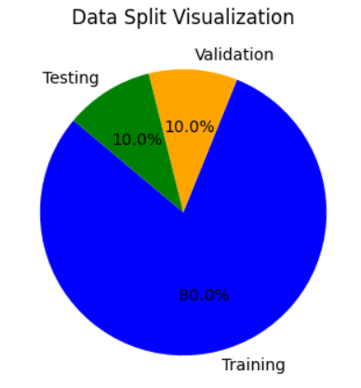
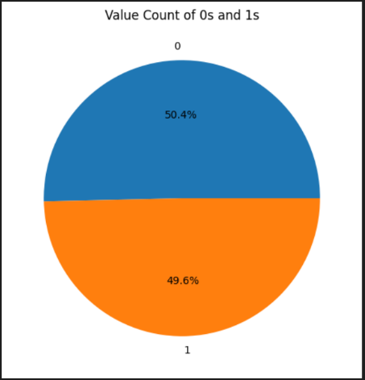
4. Data Visualization
Dataset Split:
Label-wise Split:

Slide 7
5. Data Preprocessing
Text to lowercase; removing punctuations, duplicates, null values; new column for cleaned text; etc.
6. Tokenization and Embedding Techniques
Tokenization: The text data is tokenized using the Keras Tokenizer.
Embedding: The model uses an Embedding layer to convert tokens into dense vectors

Slide 8
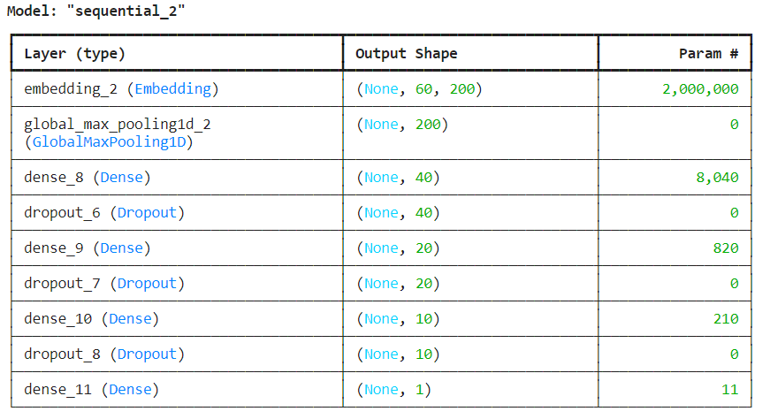
7. Modelling

Slide 9
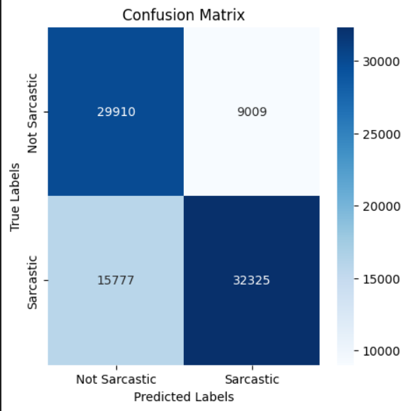
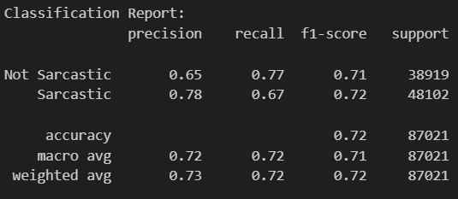
Confusion Matrix:
Classification Report:

Slide 10

Thank you

